Slide 1
Effective Regression
Testing: A Way to Improve Software Maintenance

Slide 2
Software maintenance is very important and expensive.
Development of software may take 2 to 4 years, but the same may have to be maintained for 10 to 15 years.
Software maintenance accounts for two-third of the cost of software production.

Slide 3
Software inevitably changes, whatever well-written and designed initially it may be.
There are many reasons for such changes:
  Some errors may be discovered during the actual use of the software.
  (ii) The user may request for additional functionality.
  (iii) Software may have to be modified due to change in some external policies and principles.
  For eg. when European countries had decided to go for a single European currency, this change affected all banking system software.

Slide 4
  (iv) Some restructuring work may need to be done to improve the efficiency and performance of the software.
  (v) Software may need to be modified due to change in existing technologies.
  (vi) Some obsolete capabilities may have to be deleted. etc

Slide 5
The changed software is required to be re-tested in order to ensure that changes work correctly and these changes have not adversely affected other parts of the software.
This is necessary because small changes in one part of the software program may have subtle undesired effects in other seemingly unrelated parts of the software.

Slide 6
What is regression testing
When we modify software, we typically re-test it. This process of re-testing is called regression testing.
Regression testing is the process of re-testing the modified parts of the software and ensuring that no new errors have been introduced into previously tested source code due to these modifications.

Slide 7
Regression testing tests both, the modified source code and other parts of the source code that may be affected by the change.
Regression Testing serves several purposes like:
Increases confidence in the correctness of the modified program.
Locates errors in the modified program.
Preserves the quality and reliability of the software.
Ensures the software’s continued operation.
Typically regression testing is a software maintenance activity.

Slide 8
Regression Testing Process
Regression testing is a very costly process and consumes a significant amount of resources.
“How to reduce this cost?”
Whenever a failure is experienced, it is reported to the software team.
The team may like to debug the source code to know the reason(s) for this failure.

Slide 9
After identification of the reason(s), the source code is modified and we generally do not expect the same failure again.
In order to ensure this correctness, we re-test the source code with a focus on modified portion(s) of the source code and also on affected portion(s) of the source code due to modifications.
We need test cases that target the modified and affected portions of the source code.
We may write new test cases, which may be a ‘time and effort consuming’ activity.
We neither have enough time nor reasonable resources to write new test cases for every failure.
Another option is to use the existing test cases which were designed for development testing.

Slide 10
The existing test suite may be useful and may reduce the cost of regression testing.
As, the size of the existing test suite may be very large and it may not be possible to execute all tests.
The greatest challenge is to reduce the size of the existing test suite for a particular failure..
Hence, test case selection for a failure is the main key for regression testing.

Slide 11
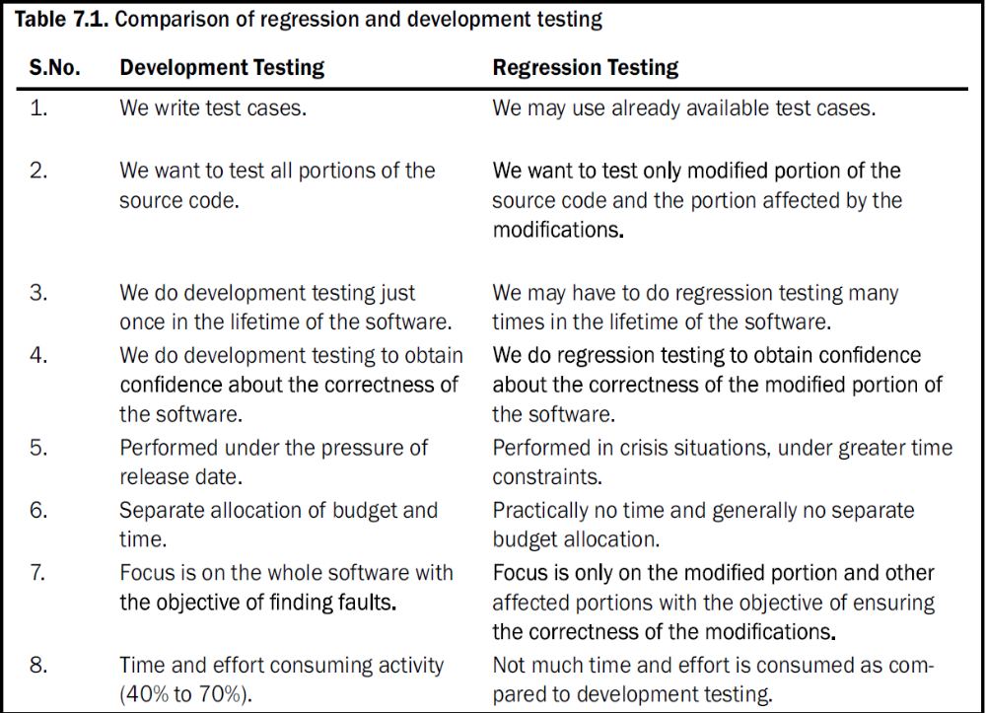

Slide 12
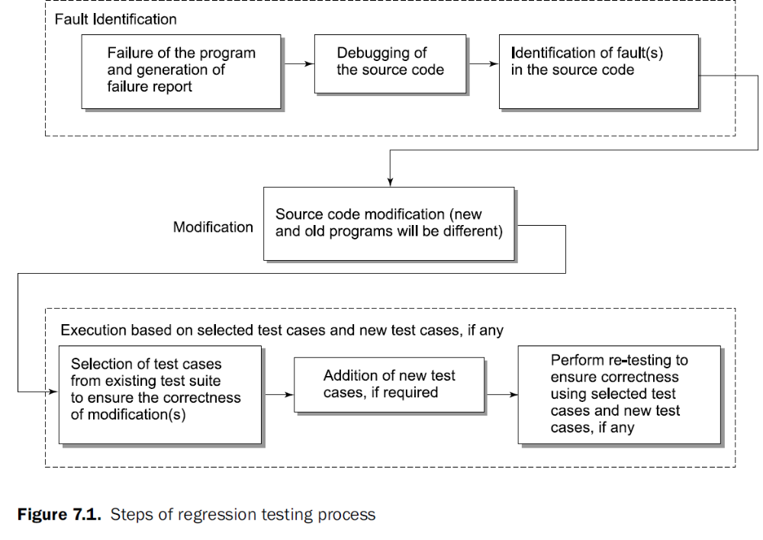

Slide 13
Selection of Test Cases
To use the existing test suite for regression testing we need to select an appropriate number of test cases for a failure?
The range is from “one test case” to “all test cases”.
A ‘regression test cases’ selection technique helps us to do this selection process.
The effectiveness of the selection technique decides the selection of the most appropriate test cases from the test suite.
Testing professionals are reluctant to omit any test case from a test suite that might expose a fault in the modified program.

Slide 14
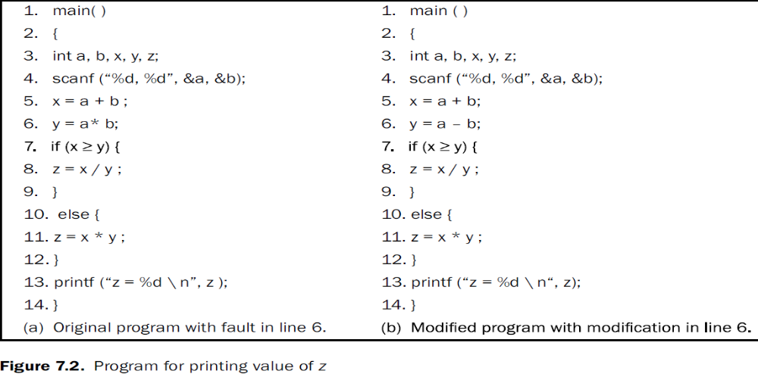
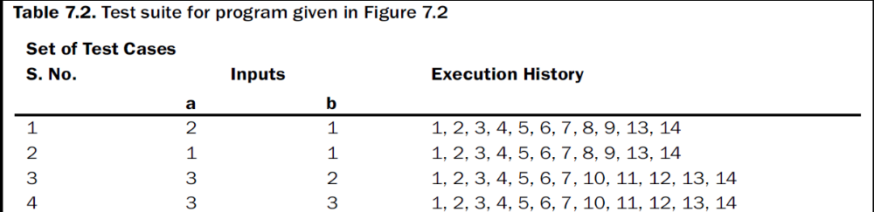

Slide 15
Let us consider a program given in Figure 7.2 along with its modified version where the modification is in line 6 (replacing operator ‘*’ by ‘-‘).
A test suite is also given in Table 7.2.
All four test cases of the test suite execute this modified line 6.
We may decide to execute all four tests for the modified program. If we do so, test case 2 with inputs a = 1 and b = 1 will experience a ‘divide by zero’ problem, whereas others will not.
If we try to reduce the number of test cases for the modified program. We may select all test cases which are executing the modified line. All four test cases are executing the modified line (line number 6) and hence are selected. There is no reduction in terms of the number of test cases.
If we see the execution history, we find that test case 1 and test case 2 have the same execution history. Similarly, test case 3 and test case 4 have the same execution history.
We choose any one test case of the same execution history to avoid repetition.
If we select test case 1, the program will execute well, but if we select test case 2, the program will experience ‘divide by zero’ problem.

Slide 16
Rule is
If several test cases execute a particular modified line, and all of these test cases reach a particular affected source code segment, minimization methods require selection of only one such test case, unless they select the others for coverage elsewhere. Therefore, either test case 1 or test case 2 may have to be selected.
If we select test case 1, we miss the opportunity to detect the fault that test case 2 detects.
Minimization techniques may omit some test cases that might expose fault(s) in the modified program. Hence, we should be very careful in the process of minimization of test cases and always try to use safe regression test selection technique (if at all it is possible).
A safe regression test selection technique should select all test cases that can expose faults in the modified program.

Slide 17
REGRESSION TEST CASES SELECTION
Many techniques are available for the selection of test cases for the purpose of regression testing.
1. Select All Test Cases
The simplest and safest technique where we do not want to take any risk.
Run all test cases for any change in the program.
A program may fail many times and every time the entire test suite is executed .
This technique is practical only when the size of the test suite is small.
For any reasonable or large sized test suite, it is impractical to execute all test cases.

Slide 18
2 Select Test Cases Randomly
Select test cases randomly to reduce the size of the test suite.
It is decided how many test cases are required to be selected depending upon time and available resources.
If the number is large, we get a good number of test cases for execution and testing may be of some use.
But, if the number is small, testing may not be useful at all.
In this technique, the assumption is that all test cases are equally good in their fault detection ability. However, in most of the situations, this assumption may not be true.
Re-test the source code for the purpose of checking the correctness of the modified portion of the program.
Many randomly selected test cases may not have any relationship with the modified portion of the program.
Random selection may be better than no regression testing at all.

Slide 19
3 Select Modification Traversing Test Cases
Select only those test cases that execute the modified portion of the program and the portion which is affected by the modification(s). Other test cases of the test suite are discarded.
Aim is to select all those test cases that reveal faults in the modified program. These test cases are known as fault revealing test cases.
There is no effective technique by which we can find fault revealing test cases for the modified program. This is the best selection approach,, but there are no techniques for the same.

Slide 20
Another objective may be to select those test cases that reveal the difference in the output of the original program and the modified program. These test cases are known as modification revealing test cases.
These test cases target that portion of the source code which makes the output of the original program and the modified program differ. There does not exist any effective technique to do this.
Therefore, it is difficult to find fault revealing test cases and modification revealing test cases.

Slide 21
The reasonable objective is to select all those test cases that traverse the modified source
code and the source code affected by modification(s). These test cases are known as
modification traversing test cases.
It is easy to develop techniques for modification traversing test cases and some are available too.
Out of all modification traversing test cases, some may be modification revealing test cases and out of some modification revealing test cases, some may be fault revealing test cases.

Slide 22
REDUCING THE NUMBER OF TEST CASES
Test case reduction is an essential activity and we may select those test cases that execute the
modification(s) and the portion of the program that is affected by the modification(s).
We may minimize the test suite or prioritize the test suite in order to execute the selected number of test cases.
Minimization of Test Cases
We select all those test cases that traverse the modified portion of the program and the portion
that is affected by the modification(s).
If the selected number is very large, it may still be reduced using any test case minimization technique.
These test case minimization techniques attempt to find redundant test cases. A redundant test case is one which achieves an objective which has already been achieved by another test case.
The objective may be source code coverage, requirement coverage, variables coverage, branch coverage, specific lines of source code coverage, etc.
A minimization technique may further reduce the size of the selected test cases based on some criteria.
Any type of minimization is risky and may omit some fault revealing test cases.

Slide 23
Prioritization of Test Cases
We may indicate the order with which a test case may be addressed. This process is known as prioritization of test cases.
A test case with the highest rank has the highest priority and the test case with the second highest rank has the second highest priority and as so on.
Prioritization does not discard any test case.
The efficiency of the regression testing is dependent upon the criteria of prioritization.
There are two varieties of test case prioritization
General test case prioritization
version specific test case prioritization.

Slide 24
General test case prioritization
Prioritize the test cases that will be useful over a succession of subsequent modified versions of the original program without any knowledge of modification(s).
Version specific test case prioritization
Prioritize the test cases, when the original program is changed to the modified program, with the knowledge of the changes that have been made in the original program.
Prioritization guidelines should address two fundamental issues like:
(i) What functions of the software must be tested?
(ii) What are the consequences if some functions are not tested?
Every reduction activity has an associated risk.
All prioritization guidelines should be designed on the basis of risk analysis.
All risky functions should be tested on higher priority.
The risk analysis may be based on complexity, criticality, impact of failure, etc.
The most important is the ‘impact of failure’ which may range from ‘no impact’ to ‘loss of human life’ and must be studied very carefully.

Slide 25
The simplest priority category scheme is to assign a priority code to every test case. The priority code may be based on the assumption that “test case of priority code 1 is more important than test case of priority code 2.
We may have priority codes as follows:
Priority code 1 : Essential test case
Priority code 2 : Important test case
Priority code 3 : Execute, if time permits
Priority code 4 : Not important test case
Priority code 5 : Redundant test case
There may be other ways for assigning priorities based on customer requirements or market
conditions like:
Priority code 1 : Important for the customer
Priority code 2 : Required to increase customer satisfaction
Priority code 3 : Help to increase market share of the product
We may design any priority category scheme, but a scheme based on technical considerations
always improves the quality of the product and should always be encouraged.

Slide 26
RISK ANALYSIS
What is Risk?
Tomorrow’s problems are today’s risks.
Risk is a problem that may cause some loss or threaten the success of the project, but, which has not happened yet.
Risk is defined as the “probability of occurrence of an undesirable event and the impact of occurrence of that event.”
To understand whether an event is really risky needs an understanding of the potential consequences of the occurrences / non-occurrences of that event.
Risks may delay and over-budget a project.
Risky projects may also not meet specified quality levels.
There are two things associated with risk:
(i) Probability of occurrence of a problem (i.e. an event)
(ii) Impact of that problem

Slide 27
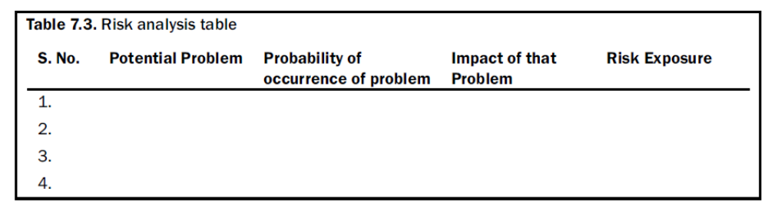
Risk analysis is a process of identifying the potential problems and then assigning a ‘probability of occurrence of the problem’ value and ‘impact of that problem’ value for each identified problem.
Both of these values are assigned on a scale of 1 (low) to 10 (high).
A factor ‘risk exposure’ is calculated for every problem which is the product of ‘probability of occurrence of the problem’ value and ‘impact of that problem’ value.
The risks may be ranked on the basis of its risk exposure.
A risk analysis table may be prepared as given in Table
These values may be calculated on the basis of historical data, past experience, intuition and criticality of the problem.
The scale of 1 to 10 is used for assigning values to both the components of the risk exposure.

Slide 28
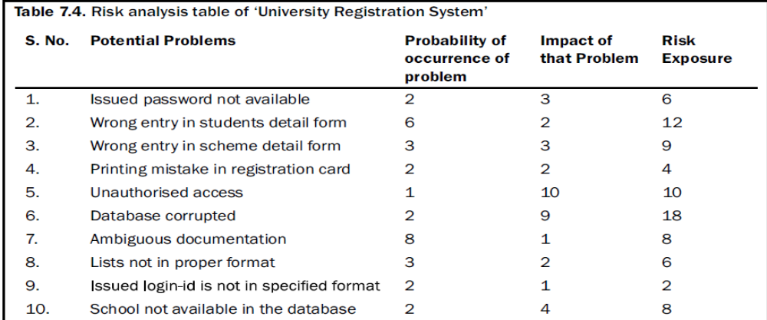
The potential problems are identified for The case study of ‘University Registration System.
The potential problems ranked by risk exposure are 6, 2, 5, 3, 7, 10, 1, 8, 4 and 9.

Slide 29
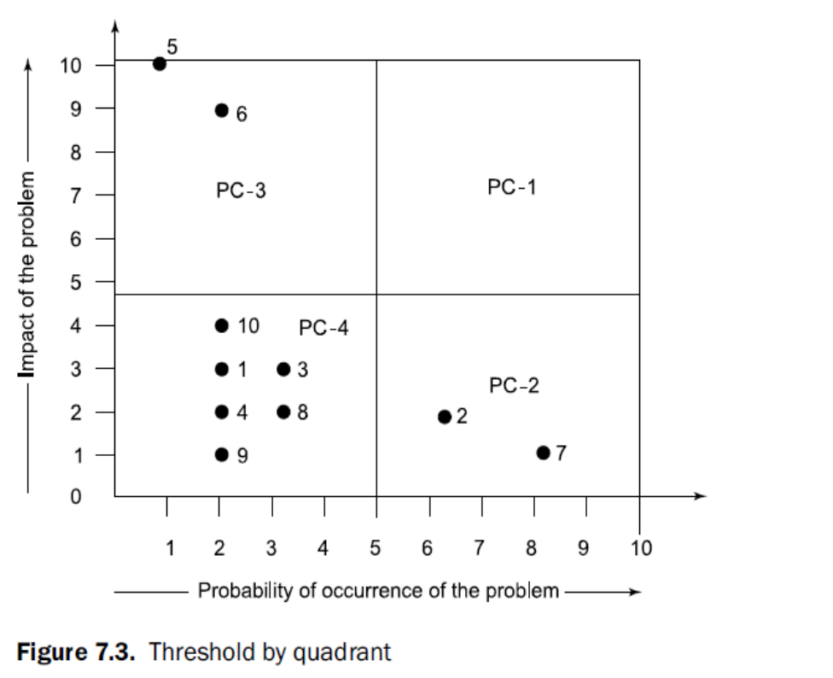
Risk Matrix
Risk matrix is used to capture identified problems, estimate their probability of occurrence with impact and rank the risks based on this information.
Risk matrix is used to assign thresholds that group the potential problems into priority categories.
The risk matrix is shown in Figure 7.3 with four quadrants. Each quadrant represents a priority category.

Slide 30
The priority category in defined as:
Priority category 1 (PC-1) = High probability value and high impact value
Priority category 2 (PC-2) = High probability value and low impact value
Priority category 3 (PC-3) = Low probability value and high impact value
Priority category 4 (PC-4) = Low probability value and low impact value
In this case, a risk with high probability value is given more importance than a problem with high impact value.
This can be changed more importance can be given to high impact value over the high probability value and is shown in Figure 7.4.
  Hence, PC-2 and PC-3 will swap, but PC-1 and PC-4 will remain the same.

Slide 31
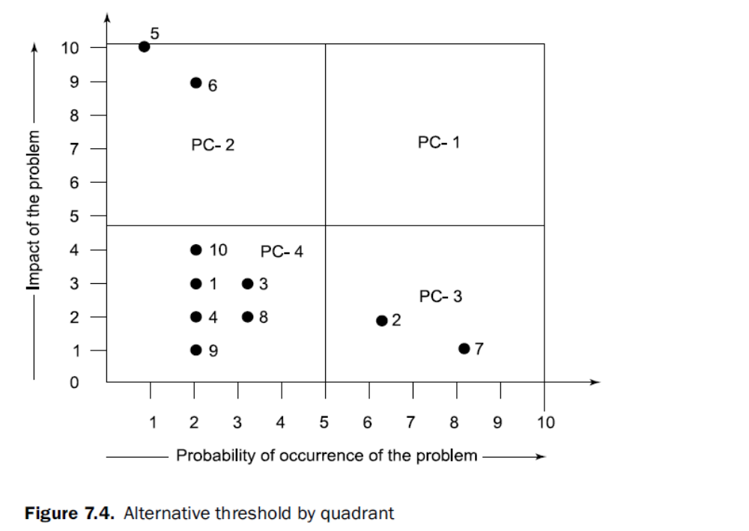

Slide 32
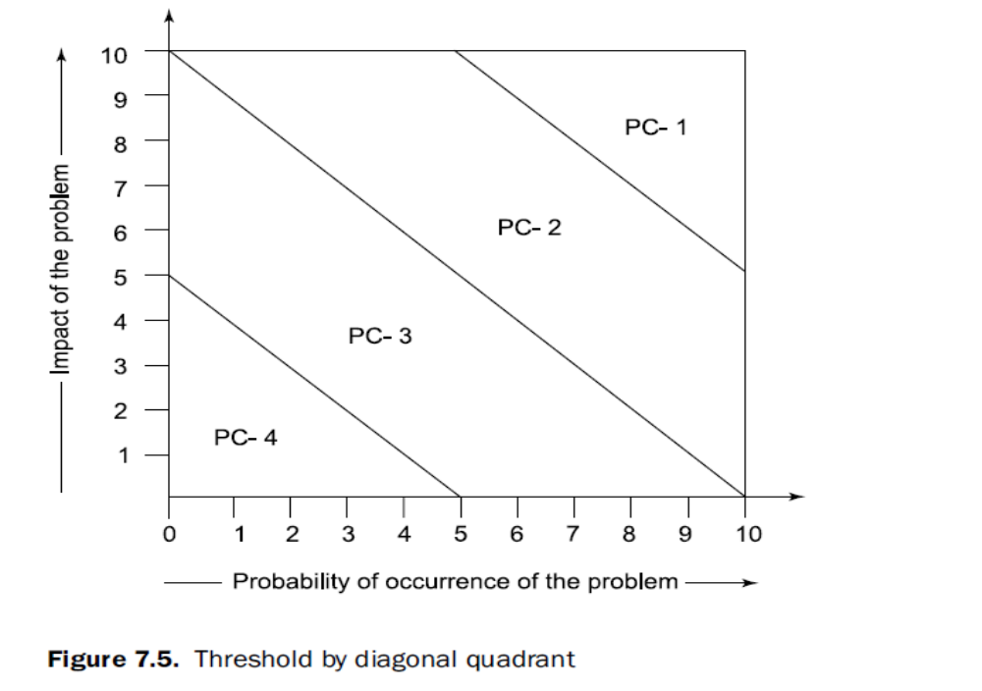
Another scheme is used in situations where we have difficulty in assigning importance to either ‘probability of occurrence of the problem’ value or ‘impact of that problem’ value.
In this case, the diagonal band prioritization scheme may be more suitable as shown in Figure 7.5.

Slide 33
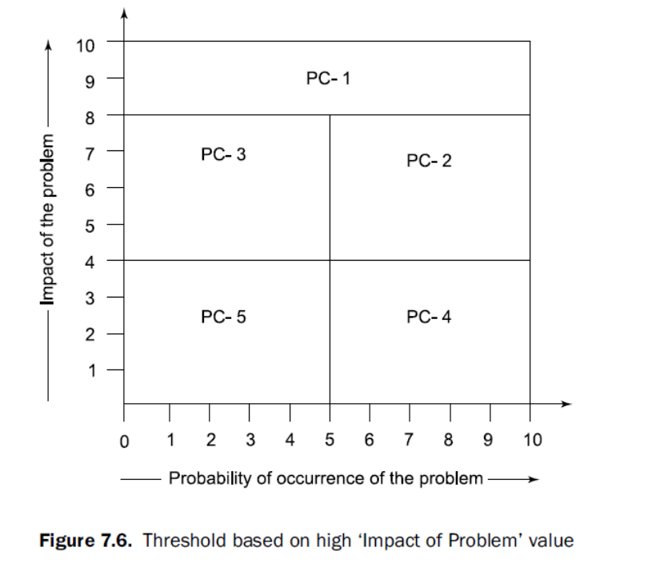
We may also feel that high impact value must be given highest priority irrespective of the ‘probability of occurrence’ value.
A high impact problem should be addressed first, irrespective of its probability of occurrence value. This prioritization scheme is given in Figure.
Here, the highest priority (PC-1) is assigned to high impact value and for the other four quadrants; any prioritization scheme may be selected.

Slide 34
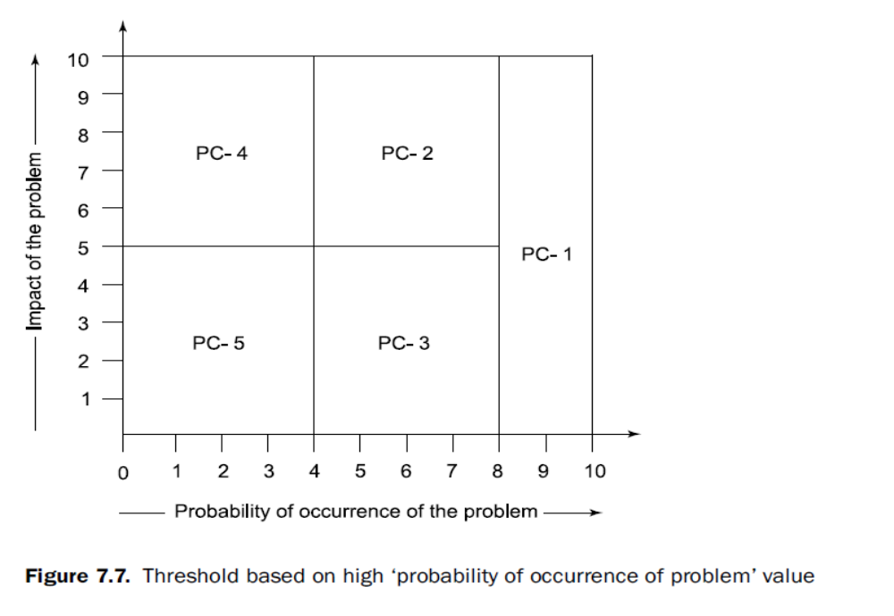
We may also assign high priority to high ‘probability of occurrence’ values irrespective of the impact value as shown in Figure.
This scheme may not be popular in practice.
Generally, the impact of the problem is of much concern. If the impact value is low, there is not much concern.
In the risk analysis table (see Table 7.4), ambiguous documentations is not considered risky faults as compared to ‘unauthorized access’
Why??

Slide 35
After the risks are ranked, the high priority risks are identified. These risks are required to be managed first and then other priority risks in descending order.
These risks should be discussed in a team and proper action should be recommended to manage these risks.
A risk matrix has become a powerful tool for designing prioritization schemes.
Estimating the probability of occurrence of a problem may be difficult in practice.
Fortunately, all that matters when using a risk matrix is the relative order of the probability estimates (which risks are more likely to occur) on the scale of 1 to 10.
The impact of the problem may be critical, serious, moderate, minor or negligible. These two values are essential for risk exposure which is used to prioritize the risks.

Slide 36
CODE COVERAGE PRIORITIZATION TECHNIQUE
We consider a program P with its modified program P` and its test suite T created to test P.
When we modify P to P` , we would like to execute modified portion(s) of the source code and the portion(s) affected by the modification(s) to see the correctness of modification(s).
We neither have time nor resources to execute all test cases of T.
Our objective is to reduce the size of T to T` using some selection criteria, which may help us to execute the modified portion of the source code and the portion(s) affected by modification(s).
A code coverage based technique based on version specific test case prioritization is described which selects T` from T which is a subset of T.
The technique also prioritizes test cases of T` and recommends use of high priority test cases first and then low priority test cases in descending order till time and resources are available or a reasonable level of confidence is achieved.

Slide 37
Test Cases Selection Criteria
The technique is based on version specific test case prioritization where information about changes in the program is known.
Prioritization is focused around the changes in the modified program.
Aim is to execute all modified lines of source code with a minimum number of selected test cases.
This technique identifies those test cases that:
(i) Execute the modified lines of source code at least once
(ii) Execute the lines of source code after deletion of deleted lines from the execution history of the test case and are not redundant.
The technique uses two algorithms one for ‘modification’ and the other for ‘deletion’. The following information is used to design the technique:
(i) Program P with its modified program P’ .
(ii) Test suite T with test cases t1, t2, t3,…..tn.
(iii) Execution history (number of lines of source code covered by a test case) of each test case of test suite T.
(iv) Line numbers of lines of source code covered by each test case are stored in a two dimensional array (t11, t12, t13,……tij).

Slide 38
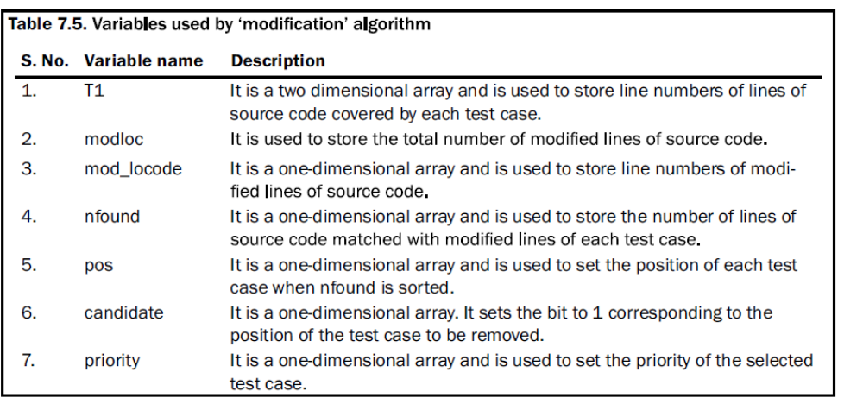
Modification Algorithm
The ‘modification’ portion of the technique is used to minimize and prioritize test cases based
on the modified lines of source code. The ‘modification’ algorithm uses the following
information
The following steps have been followed in order to select and prioritize test cases from test
suite T based on the modification in the program P.

Slide 39
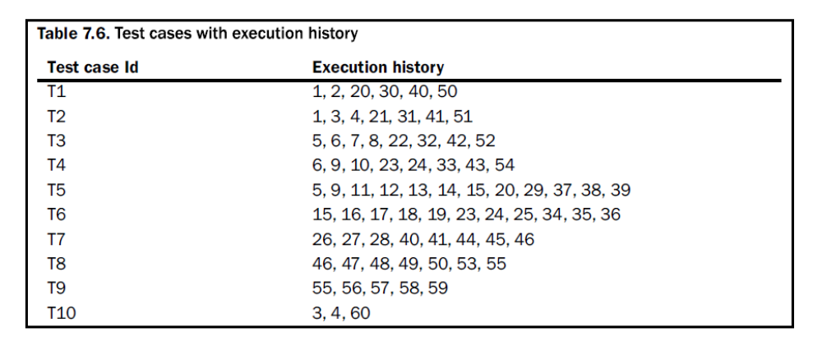
Step I: Initialization of variables
Consider a hypothetical program of 60 lines of code with a test suite of 10 test cases. The execution history is given below.
Lines 1, 2, 5, 15, 35, 45, 55 are modified.

Slide 40
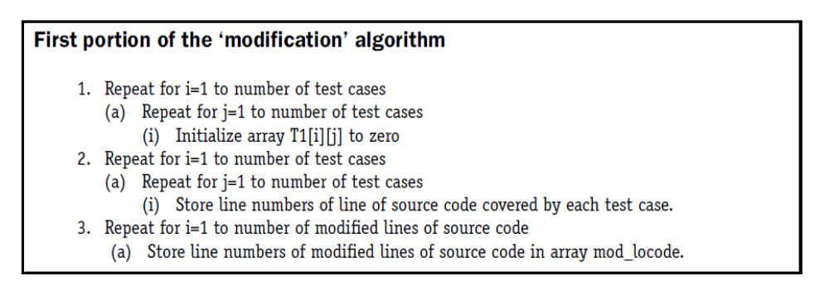
The first portion of the ‘modification’ algorithm is used to initialize and read values of
variables T1, modloc and mod_locode.

Slide 41
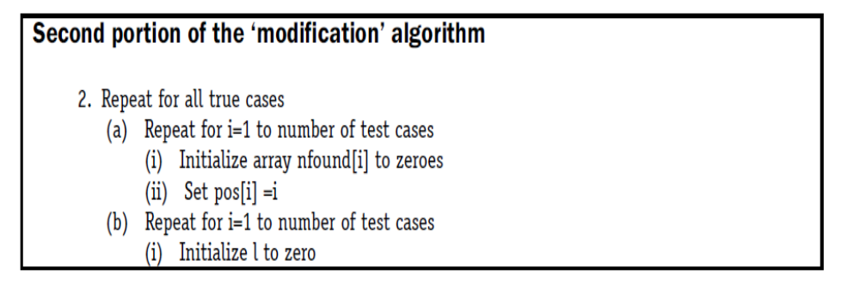
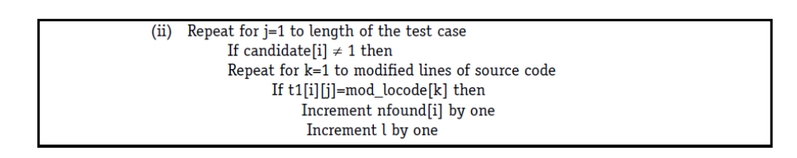
Step II: Selection and prioritization of test cases
The second portion of the algorithm counts the number of modified lines of source code covered by each test case (nfound).
The status of test cases covering modified lines of source code is given in Table 7.7.

Slide 42
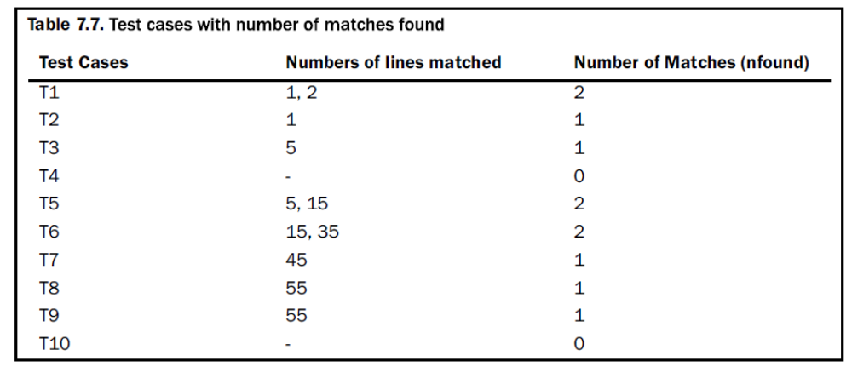

Slide 43
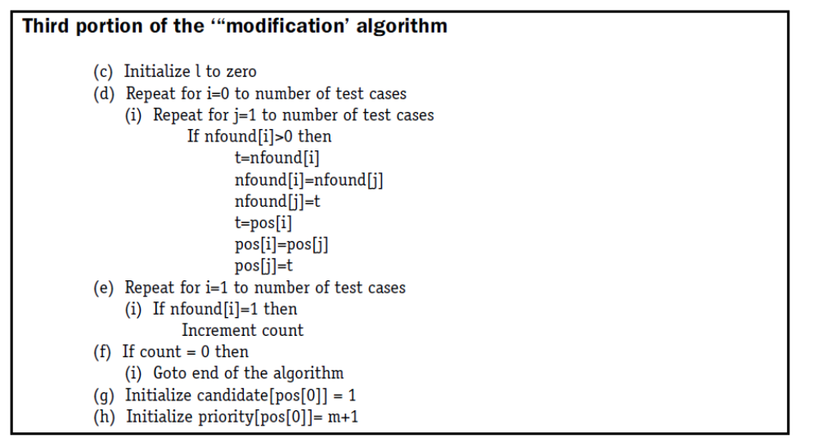
In the third portion of ‘modification’ algorithm portion, we sort the nfound array and select the test case with the highest value of nfound as a candidate for selection.
The test cases are arranged in increasing order of priority.

Slide 44
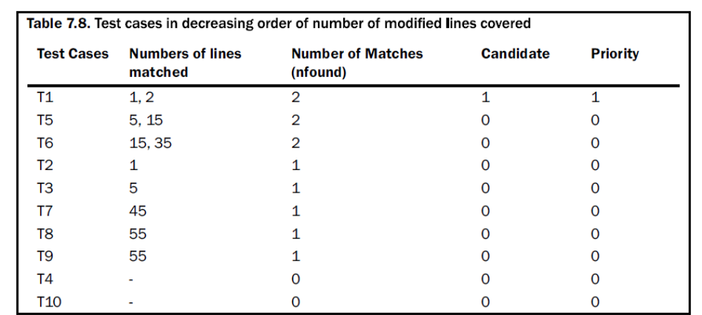
The test cases are sorted on the basis of number of modified lines covered shown below.
The test case with candidate=1 is selected in each iteration.

Slide 45
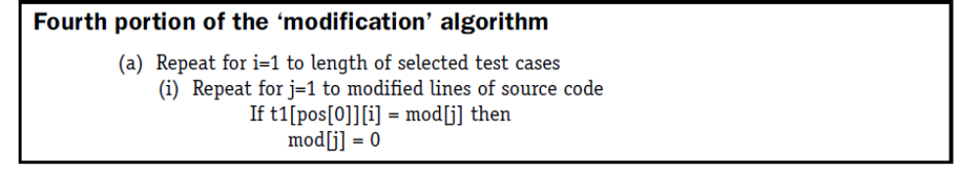
In the fourth portion of the algorithm, the modified lines of source code included in the selected test case are removed from the mod_locode array.
This process continues until there are no remaining modified lines of source code covered by any test case.

Slide 46
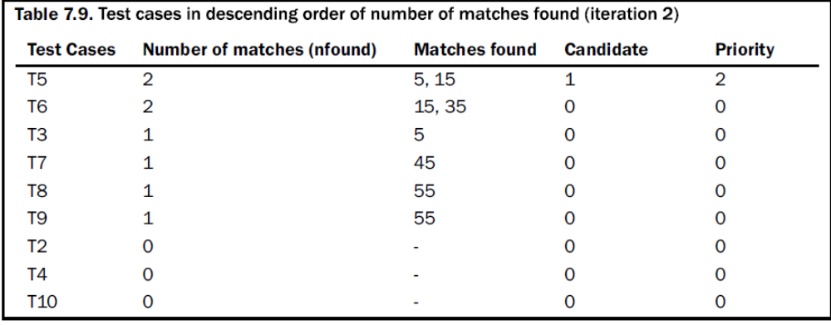
Since test case T1 is selected and it covers 1 and 2 lines of source code, these lines will be
removed from the mod_locode array.
mod_locode = [1, 2, 5, 15, 35, 45, 55] - [1, 2] = [5, 15, 35, 45, 55]
The remaining iterations of the ‘modification’ algorithm are shown in tables 7.9-7.12.
mod_locode = [5, 15, 35, 45, 55] – [5, 15] = [35, 45, 55]
mod_locode = [35, 45, 55] – [35] = [45, 55]

Slide 47
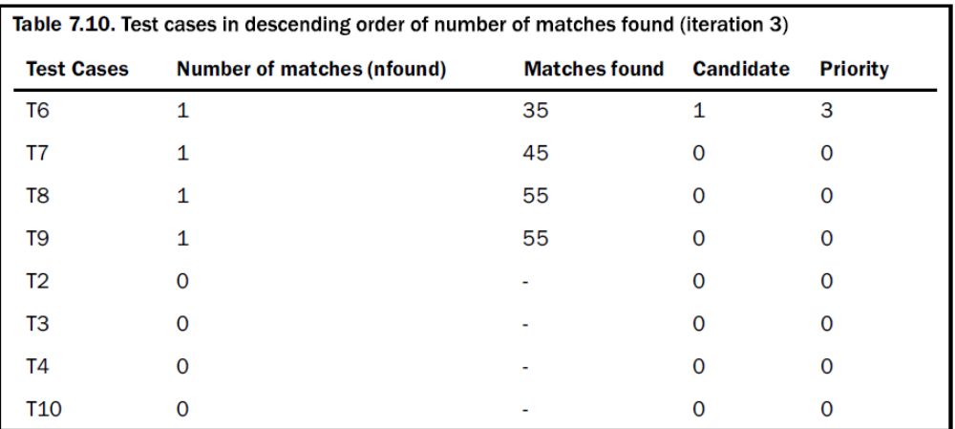

Slide 48
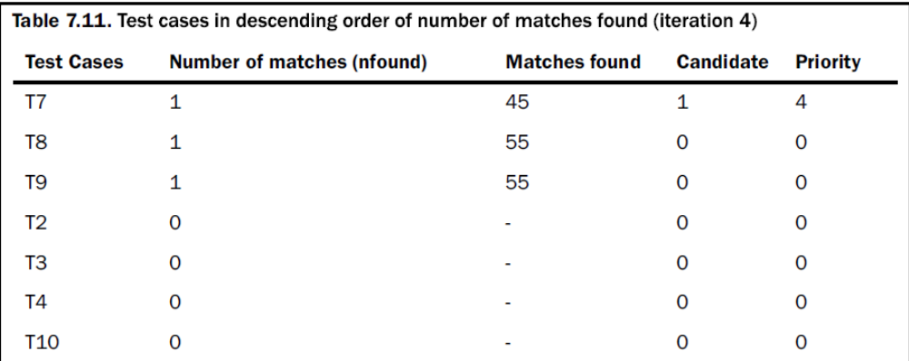
mod_locode = [45, 55] – [45] = [55]

Slide 49
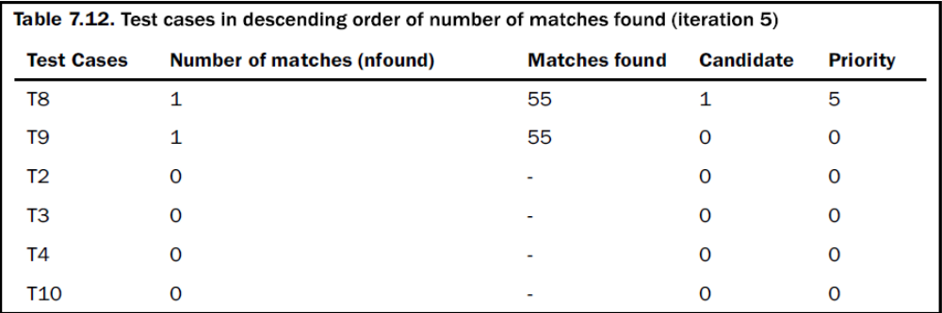
mod_locode = [55] – [55] = [Nil]
Hence test cases T1, T5, T6, T7 and T8 need to be executed on the basis of their corresponding priority.
Out of ten test cases, we need to run only 5 test cases for 100% code coverage of modified lines of source code.
This is 50% reduction of test cases.

Slide 50
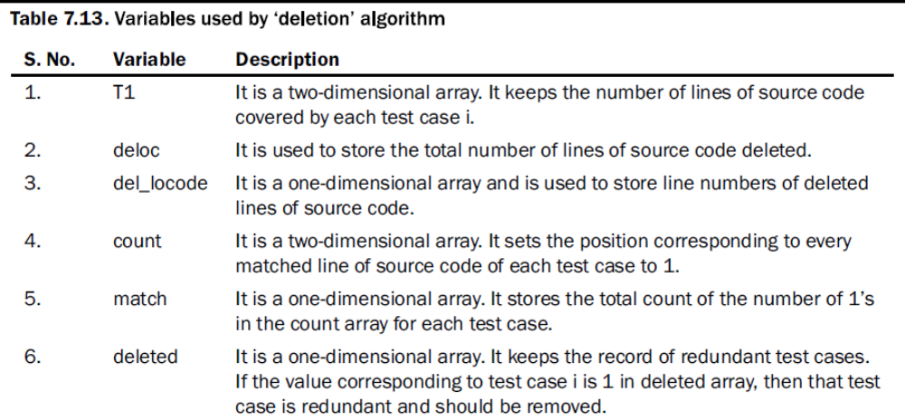
Deletion Algorithm
The ‘deletion’ portion of the technique is used to
update the execution history of test cases by removing the deleted lines of source code
identify and remove those test cases that cover only those lines which are covered by other test cases of the program.
The information used in the algorithm is given in Table

Slide 51
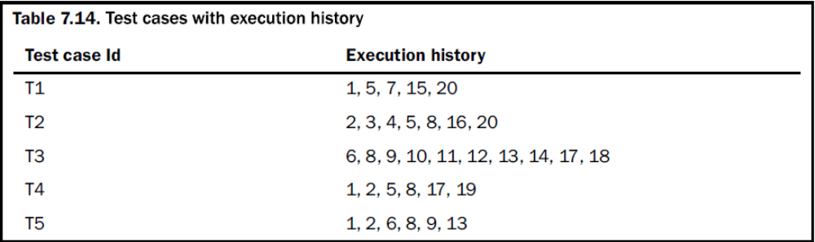
Step I: Initialization of variables
Consider a hypothetical program of 20 lines with a test suite of 5 test cases. The execution
history is given in Table

Slide 52
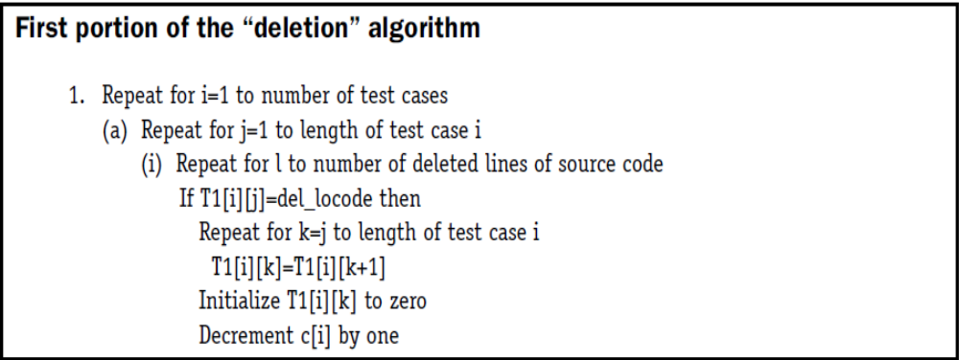
We assume that line numbers 6, 13, 17 and 20 are modified, and
line numbers 4, 7 and 15 are deleted from the source code. The information is stored as:
delloc = 3
del_locode = [4, 7, 15]
modloc = 4
mod_locode = [6, 13, 17, 20]

Slide 53
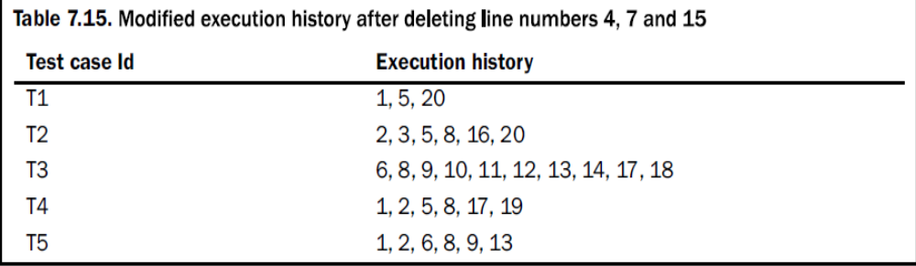
After deleting line numbers 4, 7, and 15, the modified execution history is given in Table 7.15.

Slide 54
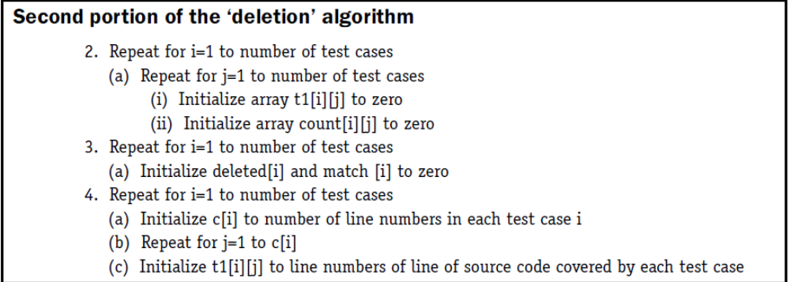
Step II: Identification of redundant test cases
A test case is a redundant test case, if it covers only those lines which are covered by other test cases of the program. This situation may arise due to deletion of a few lines of the program.
In the second portion of the ‘deletion’ algorithm, the test case array is initialized with line numbers of lines of source code covered by each test case.

Slide 55
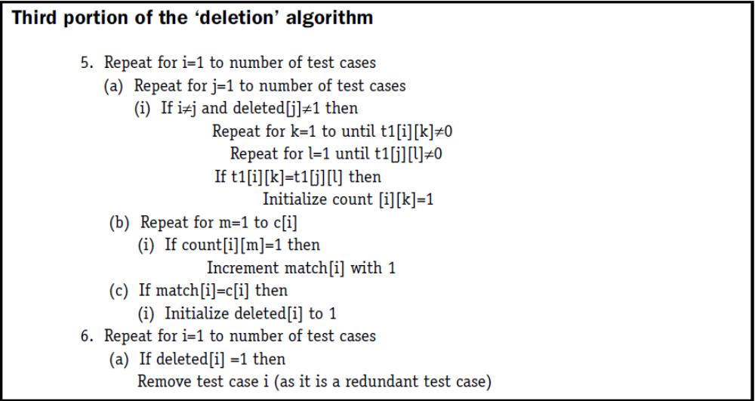
The third portion of the algorithm compares lines covered by each test case with lines covered by other test cases.
A two-dimensional array count is used to keep the record of line number matched in each test case.
If all the lines covered by a test case are being covered by some other test case, then that test case is redundant and should not be selected for execution.

Slide 56
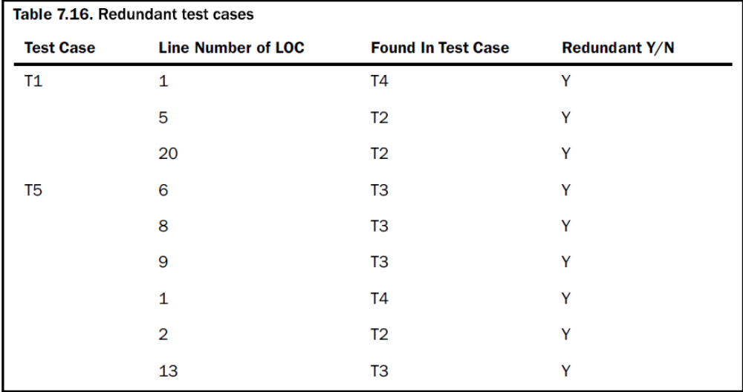
On comparing all values in each test case with all values of other test cases it is found that test case 1 and test case 5 are redundant test cases.
These two test cases do not cover any line which is not covered by other test cases as shown in Table.

Slide 57
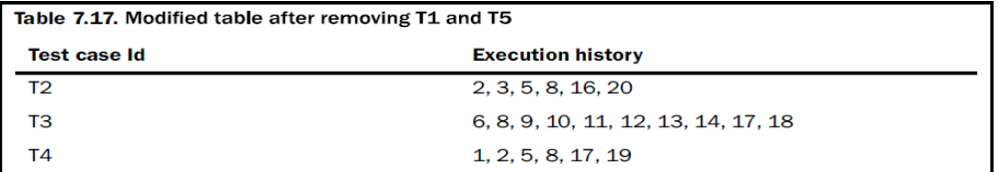
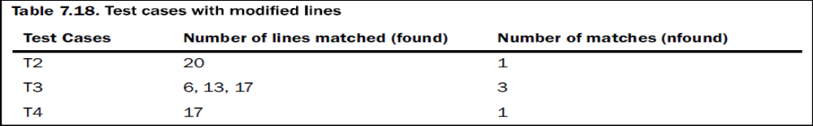
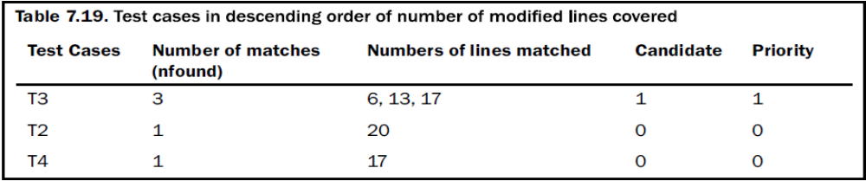
The remaining test cases are = [T2, T3, T4] and are given in Table 7.17.
Now we will minimize and prioritize test cases using ‘modification’. The status of test cases covering the modified lines is given in Table 7.18.
Test cases are sorted on the basis of number of modified lines covered as shown in tables 7.19-7.20.

Slide 58
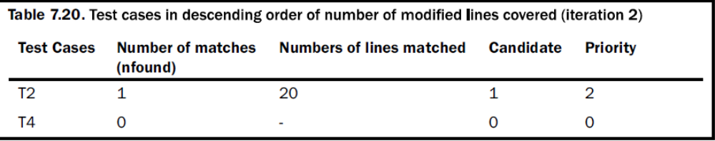
mod_locode = [6, 13, 17, 20] – [6, 13, 17] = [20]
Test cases T2 and T3 are needed to be executed and redundant test cases are T1 and T5.
Out of the five test cases, we need to run only 2 test cases for 100% code coverage of modified code coverage.
This is a 60% reduction.
If we run only those test cases that cover any modified lines, then T2, T3 and T4 are selected. This technique not only selects test cases, but also prioritizes test cases.

